Slide 1
視窗程式設計
Homework#3: A tool for drawing lines
作業三：畫線程式
元智資工

Slide 2
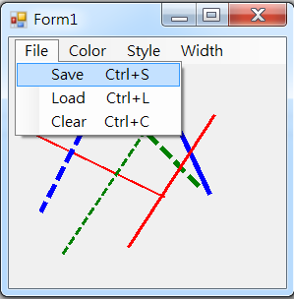
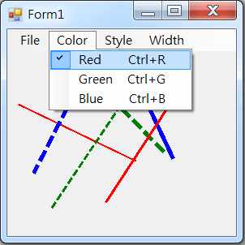
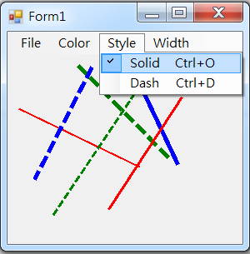
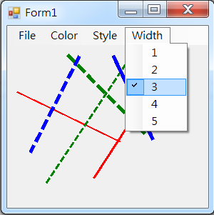
HW#3：Write a program for drawing lines
Enabling users to draw a line through pushing the left button of the mouse as the begin point of the line and releasing the left button of the mouse as the end point of the line
Including four menu items to save, load, and clear lines, to change the color (red, green, or blue), the width (1~5), and the style (solid or dash) of the next drawing line

Slide 3
作業三：撰寫一個畫線的視窗應用程式
以按下滑鼠左鍵為起點，放開滑鼠左鍵為終點來繪製線段
具備下圖的四個子選單
  可透過選單控制線段的顏色(紅或綠或藍)、粗細(1~5)、與種類(實線或虛線)
  可儲存、載入、或清除所繪製的線段

